Slide 1
Deep Q-Networks for Intelligent Decision-Making MLA0301 REINFORCEMENT LEARNING
PRESENTED BY
A SHIVA SHANKAR REDDY
192425174

Slide 2
INTRODUCTION
Deep Q-Network (DQN) is a reinforcement learning algorithm that combines Q-Learning with Deep Neural Networks to enable intelligent decision-making. It allows an agent to learn the best actions by interacting with an environment and receiving rewards or penalties.
Unlike traditional Q-Learning, which stores Q-values in a table, DQN uses a neural network to estimate Q-values, making it suitable for large and complex state spaces. Techniques such as Experience Replay and Target Networks improve the stability and efficiency of training.
DQN has been successfully applied in areas such as robotics, autonomous vehicles, game playing, industrial automation, and intelligent control systems.

Slide 3
DQN Architecture & Working
Main components:
Environment
Provides the current state
Receives the selected action
Deep Neural Network
Takes state as input
Produces Q-values for possible actions
Action Selection
Selects the action with the highest Q-value
Reward
Environment provides feedback
Working Cycle:
State → DQN → Action → Environment → Reward + Next State → DQN
Example: For an autonomous vehicle, the state may contain information about nearby vehicles, road conditions, and traffic signals. DQN chooses actions such as accelerate, brake, or change lane.

Slide 4
Experience Replay
Experience Replay is a technique used to make DQN training more stable and efficient.
Each experience is stored as:
(State, Action, Reward, Next State)
How it works:
Agent interacts with the environment.
Experiences are stored in a Replay Memory.
Random samples are taken from the memory during training.
Neural network learns from these sampled experiences.
Advantages:
Reduces correlation between consecutive experiences
Improves learning stability
Reuses past experiences
Makes training more efficient
Simple flow:
Experience → Replay Memory → Random Batch → DQN Training

Slide 5
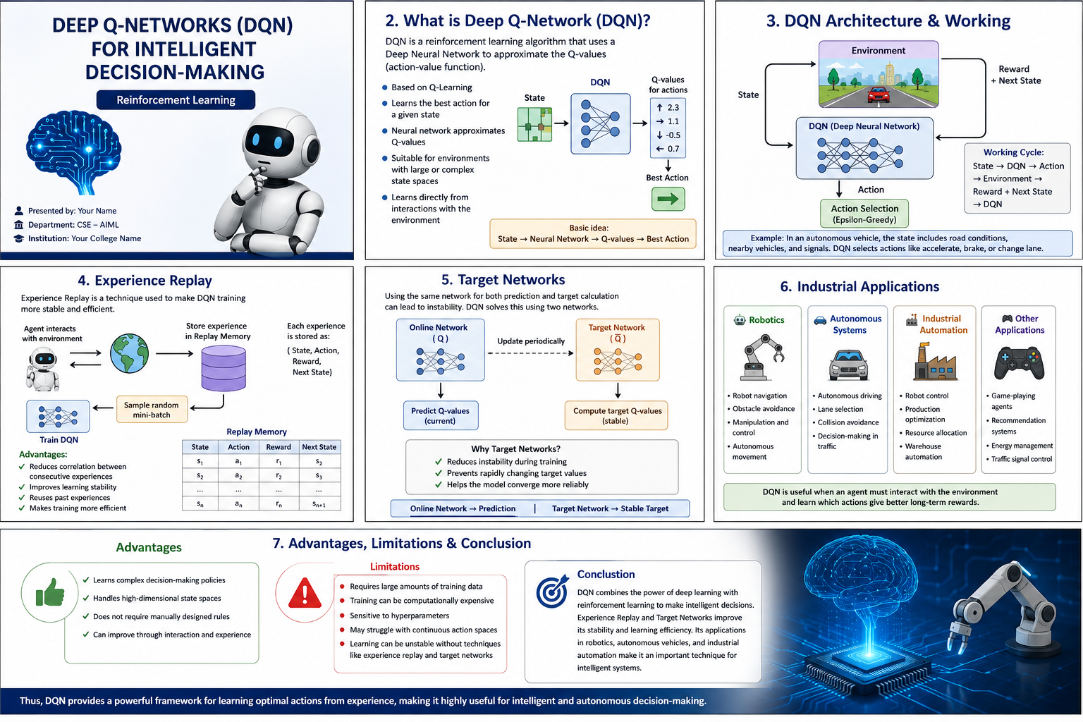
Industrial Applications
Robotics
Robot navigation
Obstacle avoidance
Manipulation and control
Autonomous movement
Autonomous Systems
Autonomous driving
Lane selection
Collision avoidance
Decision-making in traffic
Industrial Automation
Robot control
Production optimization
Resource allocation
Warehouse automation

Slide 6
ADVANTAGES AND LIMITATIONS
Advantages
Learns complex decision-making policies
Handles high-dimensional state spaces
Does not require manually designed rules
Can improve through interaction and experience
Limitations
Requires large amounts of training data
Training can be computationally expensive
Sensitive to hyperparameters
May struggle with continuous action spaces
Learning can be unstable without techniques such as experience replay and target networks

Slide 7
CONCLUSION
DQN combines the power of deep learning with reinforcement learning to make intelligent decisions. Experience Replay and Target Networks improve its stability and learning efficiency.
Its applications in robotics, autonomous vehicles, and industrial automation make it an important technique for intelligent systems
“Thus, DQN provides a powerful framework for learning optimal actions from experience, making it highly useful for intelligent and autonomous decision-making.”

Slide 8
THANK YOU…

